Slide 1

Course Introduction
What (and how) are we going to learn?
Yordan Darakchiev
Technical Trainer
iordan93@gmail.com

Slide 2
Table of Contents
Course objectives
Prerequisites
Curriculum
Course schedule
Trainer
Lecture format
Final exam
Some learning resources

Slide 3
Course Objectives
Teaching computers how to do stuff

Slide 4
Course Objectives
Learn the basics of how data modelling works
Learn what machine learning is and how it helps make decisions, automate tasks, etc.
Learn what the basic algorithms are and how they work
Apply machine learning to real data to get insights
Do at least one complete project
Data preparation
Choosing algorithms
Model training, improvement, and selection
Presenting a complete solution
Communicating results and ensuring reproducibility

Slide 5
Prerequisites
Intermediate English
Programming Basics
Math Concepts
Have basic logic and intuition
Understand what is written on the slides
Scientific Mindset
Be open to (and not afraid of) challenges
Understand what variables and for-loops are
Software development experience is a plus but not required
Know a little about algebra and statistics

Slide 6
Course Format Details
Curriculum, schedule, trainer, lecture format, exam

Slide 7
Curriculum
Introduction to machine learning
Linear and logistic regression
Model training and improvement
Tree and ensemble models
Support vector machines
Clustering
Dimensionality reduction
Introduction to neural networks
Exam preparation: complete, end-to-end project

Slide 8
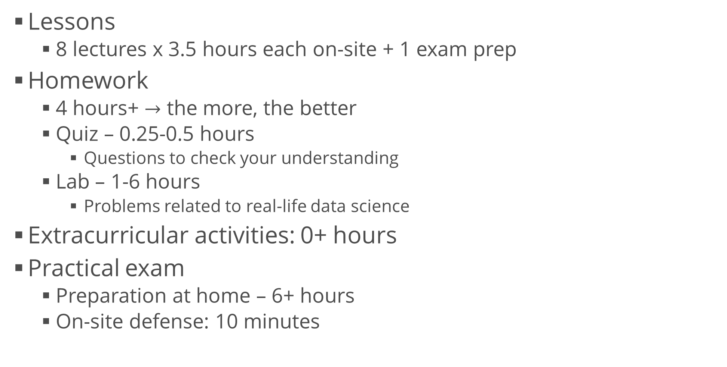
Course Schedule
Lessons
8 lectures x 3.5 hours each on-site + 1 exam prep
Homework
4 hours+ $→$ the more, the better
Quiz – 0.25-0.5 hours
Questions to check your understanding
Lab – 1-6 hours
Problems related to real-life data science
Extracurricular activities: 0+ hours
Practical exam
Preparation at home – 6+ hours
On-site defense: 10 minutes

Slide 9
Final Exam
Practical project
Work on your own
No teams allowed
Present your results (documentation, code, models, Web services, etc.) in a limited amount of time
Work on a given assignment
Perform research
Scientific papers, community forums, etc.
Analyze the data
Train one or more machine learning algorithms
Select and improve models
Document all your findings
Communicate the results
Optionally… do whatever you like :D

Slide 10
Grading Scheme
Quizzes: up to 10%
Due 2 weeks after the lecture date
Most questions allow for 3 attempts
Labs: up to 20%
Due 2 weeks after the lecture date
Final exam: up to 70%
Develop at your own pace
Upload deadline: 13 April 2018, 23:59:59 GMT+3
On-site defense: 15 April 2018, 09:00:00 GMT+3
To qualify: at least 5/30 points from quizzes and labs
Forum activity: bonus up to 10%

Slide 11
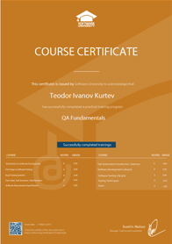
Grading and Course Certificate
All students will be graded on a scale from 2.00 to 6.00
The same way the standard grading in Bulgaria works
Everyone who scores ≥ 5.00 (total) on the course will get a certificate from SoftUni
Starting point for a new career or continuing education in your current field
Career assistance
The SoftUni career center will help you find work
Official and recognizable
Employers value certificates
Proof of hard work :)
Shareable and verifiable

Slide 12
Who Am I?
Programmer
.NET Web developer
Graduated Telerik Academy in Oct 2013 with distinction
Trainer
Various programming courses
To beginners and experienced developers
Scientific (and popular) lectures
Scientist / Enthusiast
BSc in Astrophysics (July 2016)
Currently pursuing a MSc in Astrophysics
Overall nerd
Curious and skeptical

Slide 13
Learning Resources
Learn more and share your knowledge

Slide 14
SoftUni Course Pages
Official Web page of this course
https://softuni.bg/trainings/1890/machine-learning-february-2018
Forum category
Open courses > Machine Learning
Ask and answer questions
I will try to answer your questions as well
Post what you've learned
Links to resources, code snippets, ideas, tips and tricks
Share your problems (homework or not) and help solve them
Create and maintain a community
A critical part of software development and science
ML Bulgaria Facebook group
https://www.facebook.com/groups/machine.learning.bg/

Slide 15
Online Resources
Books
"How not to be wrong" – Jordan Ellenberg
"The Elements of Statistical Learning" – Stanford (free PDF)
… and anything else you can find
Websites
Communities: Kaggle, Quora, Stack Exchange
Online courses: Coursera, edX, MIT OCW, Stanford, etc.
YouTube
FunFunFunction, Daniel Shiffman, Siraj Raval, AsapSCIENCE, Veritasium, Vsauce, TedEd, CrashCourse, Mind Your Decisions, Infinite Series, Numberphile, Computerphile, Vi Hart, 3Blue1Brown, blackpenredpen, Mathologer, and many more

